Slide 1
FP Growth Algorithm

Slide 2
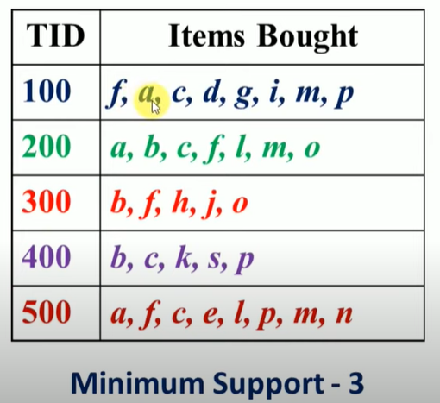
Dataset

Slide 3
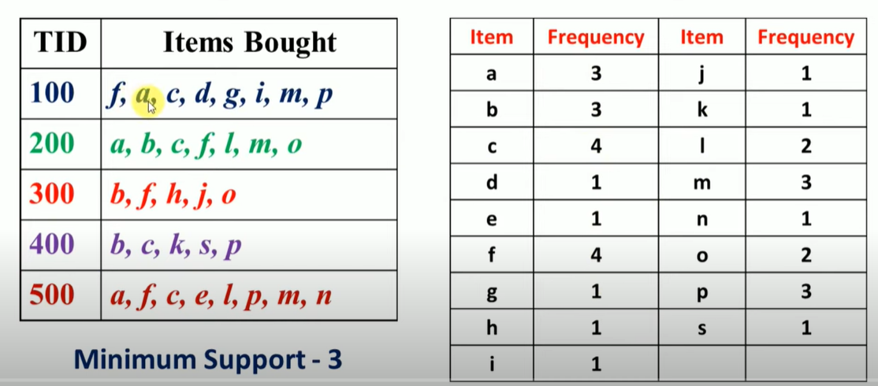
Step: calculate frequency of each item

Slide 4
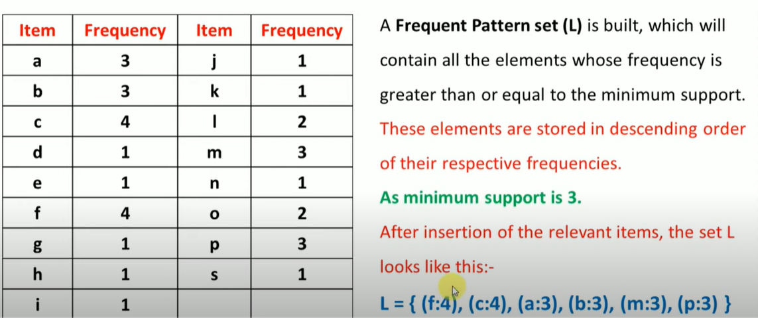
Step: calculate Frequent pattern set (L)

Slide 5
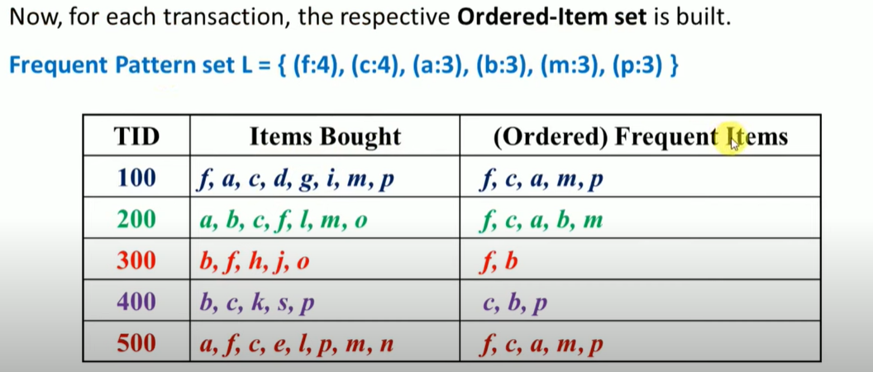
Step: create Ordered Frequent Items

Slide 6
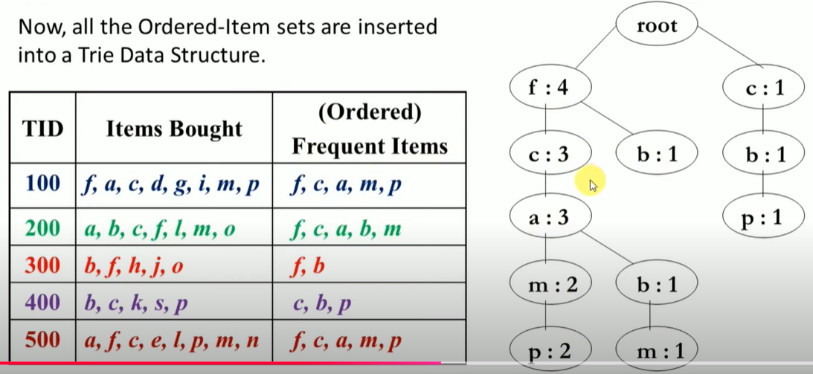
Step: Create Frequent pattern Tree

Slide 7
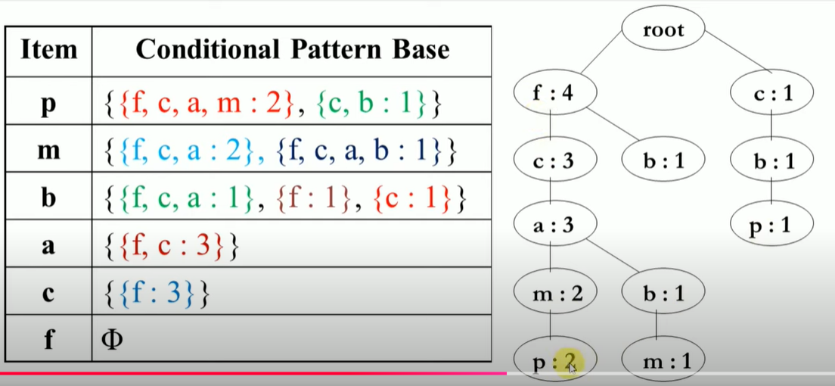
Step: Conditional pattern Base

Slide 8
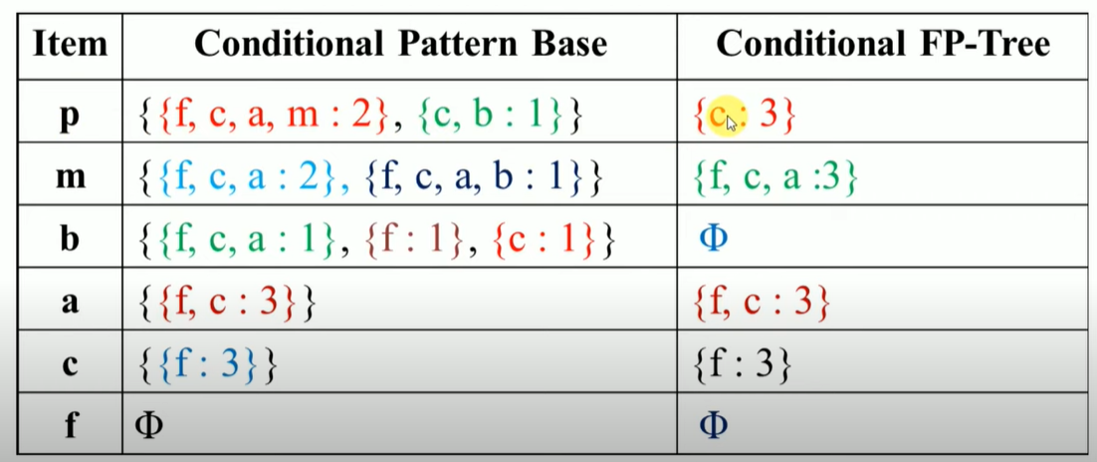
Step: Conditional Frequent Pattern tree

Slide 9
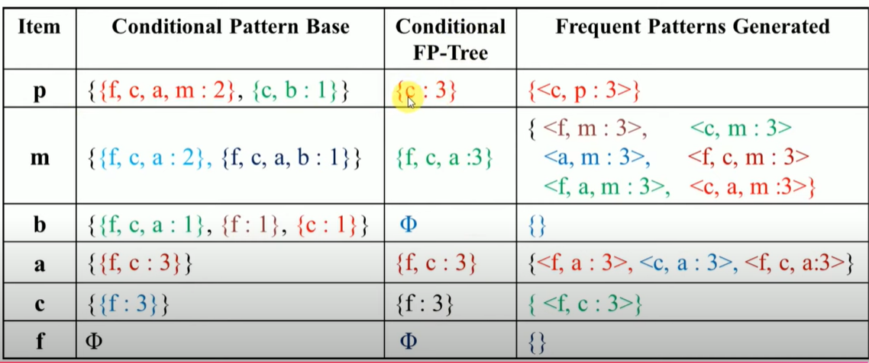
Frequent pattern rules

